Slide 1
Module 2 - Output Primitives Topic: Midpoint Algorithm for Ellipse
By Poonam Pangarkar
Department of CSE Data Science APSIT

Slide 2
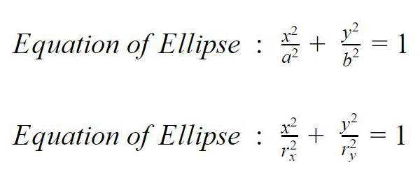
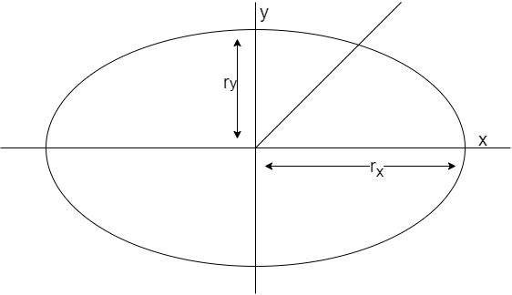
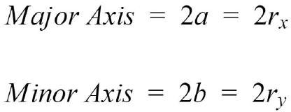
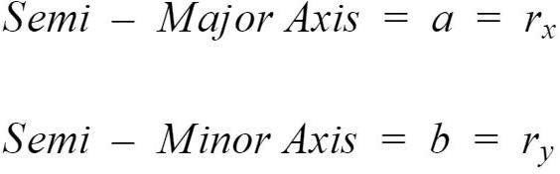
Ellipse
45°

Slide 3
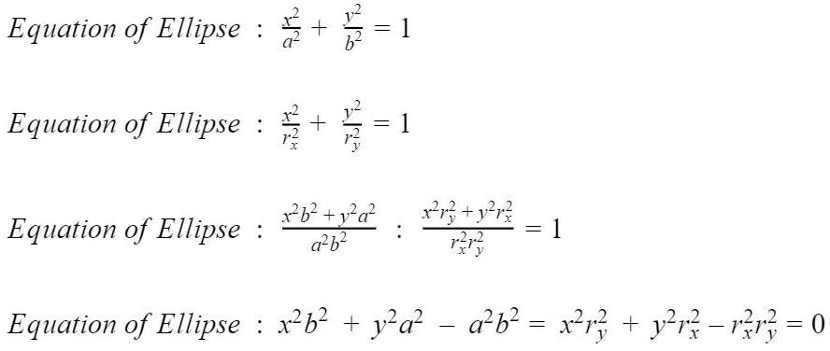
Equation of Ellipse
If = 0, Point Lies on the Ellipse
If < 0, Point Lies inside the Ellipse
If > 0, Point Lies outside the Ellipse

Slide 4
Ellipse Features
Circle has 8-way symmetry and so can be represented with 8 octants
Ellipse has just 4-way symmetry and so can only be represented with 4 Quadrants
For circle we need to plot only one octant but for ellipse we need to plot an entire quadrant.

Slide 5
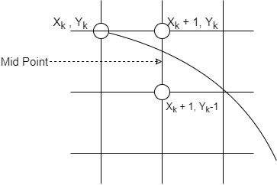
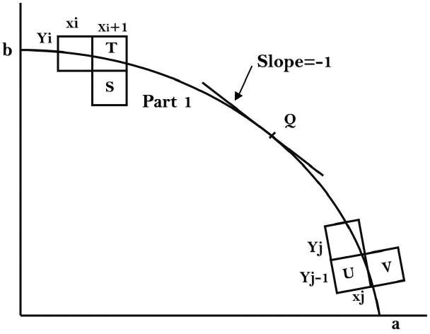
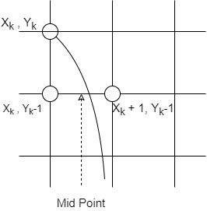
Understanding the Midpoint
So we divide the quadrant into two Regions R1 and R2

Slide 6
Regions
Quadrant 1 : Region 1
Starting Point : ( 0, r_{y} )
Slope of the curve < -1
Take unit steps in positive X direction till boundary between the two regions is reached
Quadrant 1 : Region 2
Slope of the curve > -1
Take unit steps in negative Y direction till the end of the quadrant is reached
On the boundary between the two regions, the slope of the curve is -1.

Slide 7
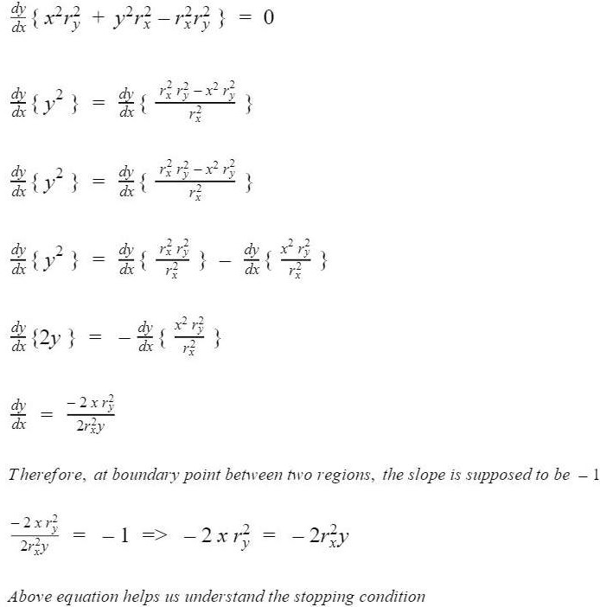
Slope of the Curve

Slide 8
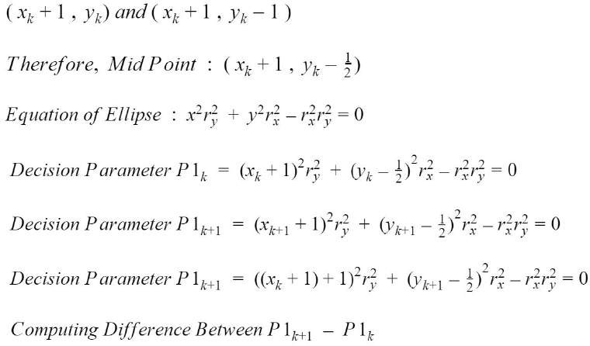
Derivation for Region 1

Slide 9
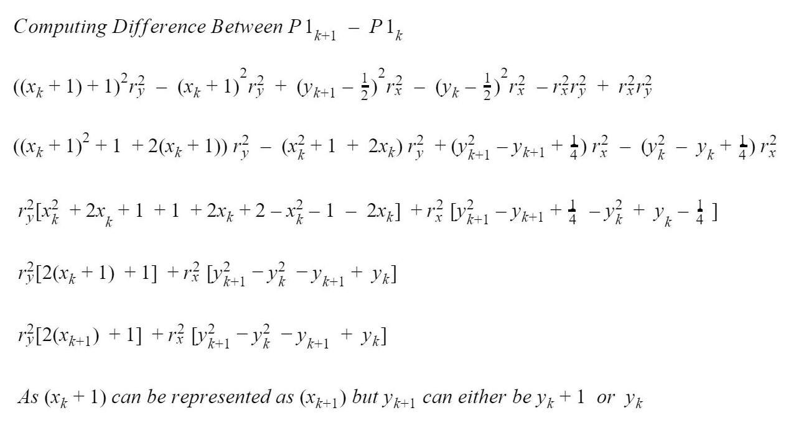
Derivation for Region 1

Slide 10
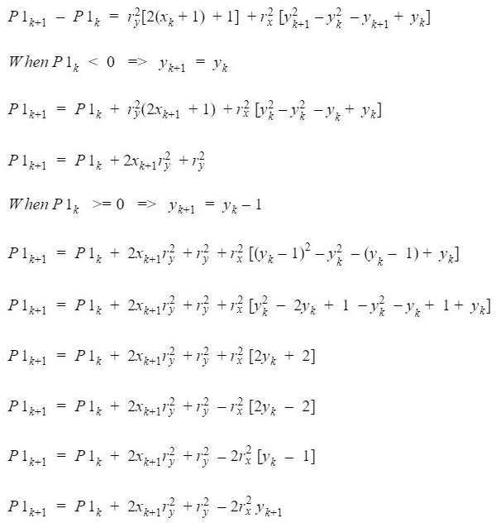
Derivation for Region 1

Slide 11
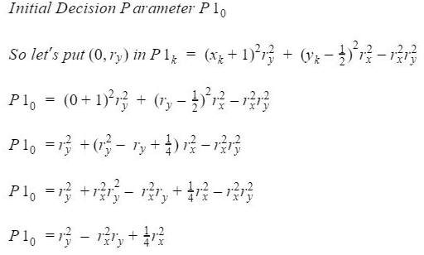
Initial Decision Parameter for Region 1

Slide 12
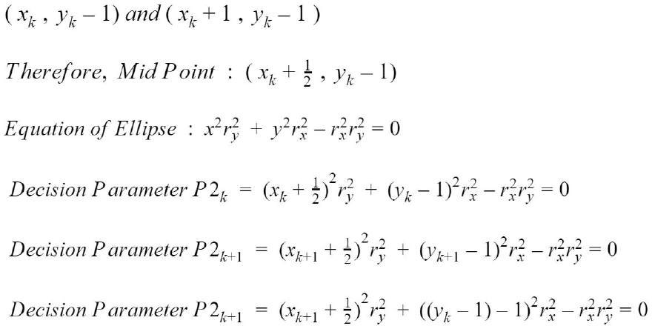
Derivation for Region 2

Slide 13
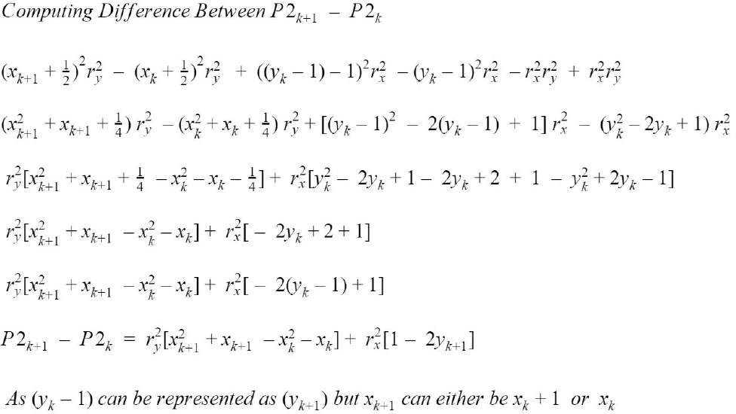
Derivation for Region 2

Slide 14
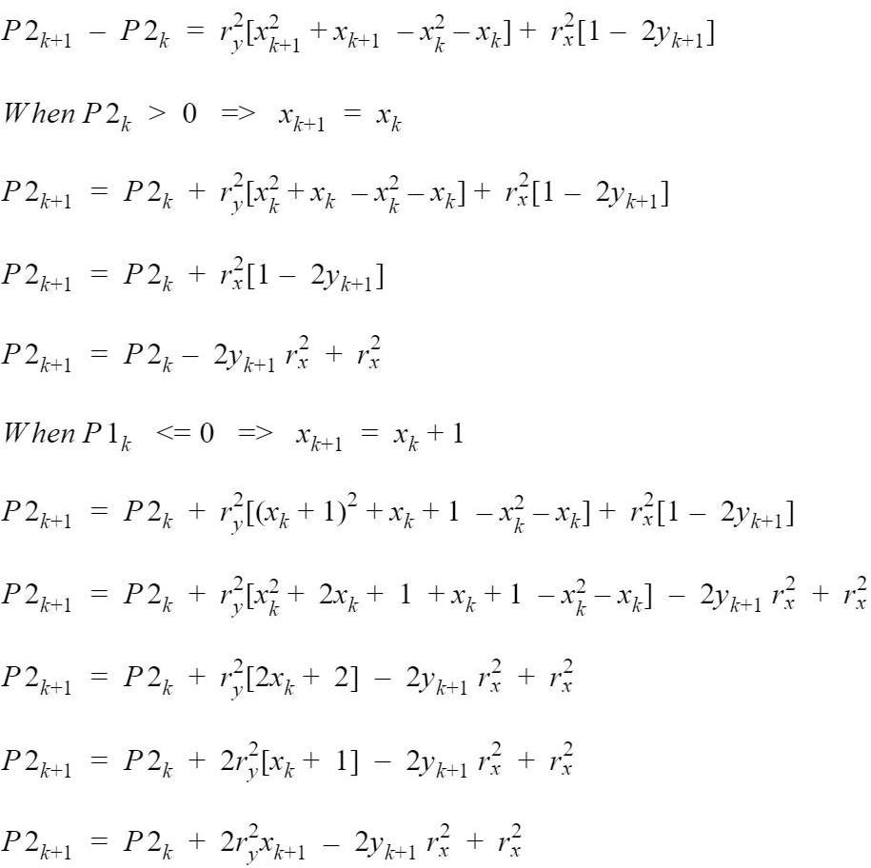
Derivation for Region 2

Slide 15
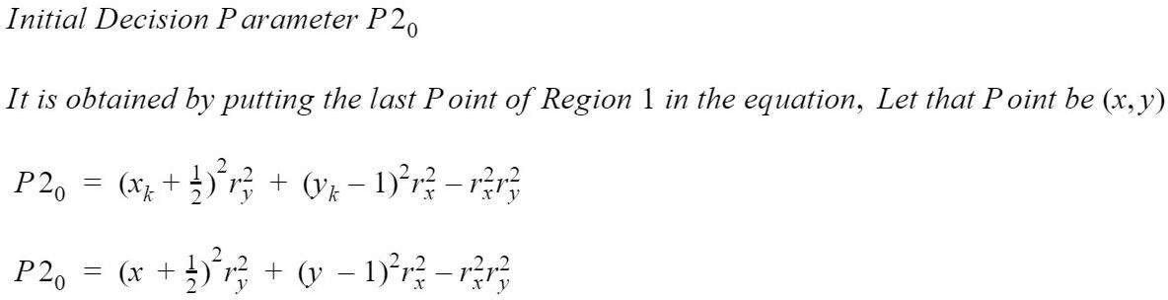
Initial Decision Parameter for Region 2

Slide 16
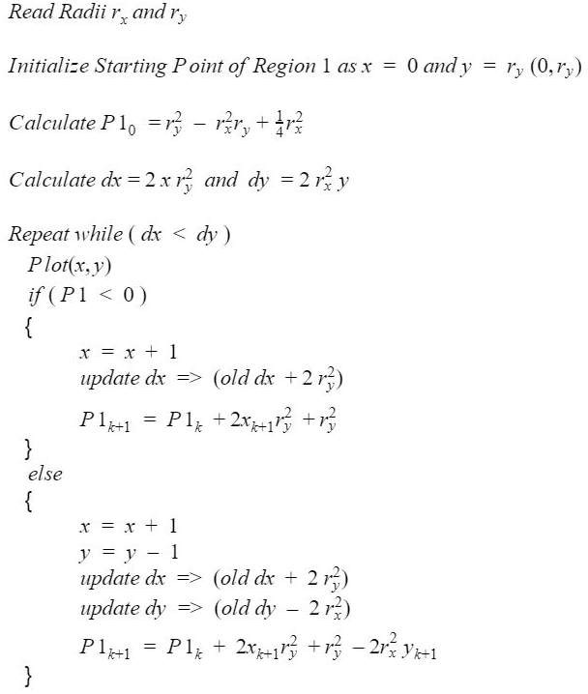
MidPoint Ellipse Drawing

Slide 17
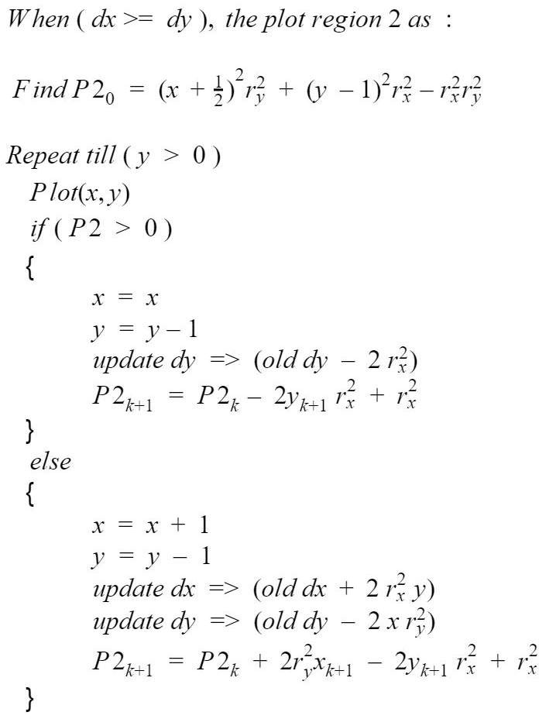
MidPoint Ellipse Drawing

Slide 18
References
Hearn & Baker, “Computer Graphics C version”, 2nd Edition, Pearson Publication

